Slide 1
Learning from community experience with HIV high-level meetings
Mary Ann Torres
Secretariat Stakeholders Task Force
2016 HIV HLM

Slide 2
2016 HLM on HIV
HLM on HIV → 8 to 10 June 2016
6 months of intense work
(selection of STF, development of CSH,
negotiation of PD, organization of HLM)
Resulted in Political Declaration

Slide 3
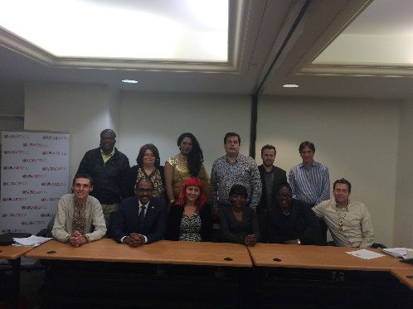
Stakeholders Task Force (12 members)
1 representative each of 4 key populations:
people who use drugs
sex workers
Transgender*
men who have sex with men
Indigenous populations*
Women
Youth
Others
7 people openly living with HIV
* Mentioned as stand-alone groups for first time

Slide 4
Input to these reflections
STF
Global networks of key populations
Organizations that supported/facilitated process

Slide 5
Some preliminary/overall reflections:
Need for stronger regional perspectives, ensure a better balance between “top-down bottom-up” approaches
Accept and address power imbalance between north and south
Identify which national partners have the capacity to be involved in a global policy process
Better coordination to diminish the amount of information (some time duplicative).
to success? – transparent and trusting relationship with co-facilitators and identifying allies earlier in the process

Slide 6
3 stages of HLM “process”
Before
Before CSH
After CSH
During
negotiation
approval
After
implementation
Accountability/ reporting

Slide 7
BEFORE
Clear priorities and red lines
Consensus among diverse stakeholders
Inclusive of all issues/populations/regions
Specific language (and provide alternatives)
Include language that is non-negotiable
Include issues and language that is unacceptable
If possible, add targets/indicators
Visit to UN Missions to share priorities
Always with advocates from regions/countries
Engage and support country advocates
Better engagement between STF and OPGA and facilitators

Slide 8
DURING
Better alignment between capitals and UN Missions (NY).
Simultaneously liaise with all involved in negotiations
Understand and support roles of different stakeholders
Understand limitations of process (not very consultative o transparent)
Negotiators in NY have no technical expertise
Outcome document is negotiated → minimum common denominator
Document country positions in diff. issues -> identify negotiation points

Slide 9
Database - country positions
Issue | S&D | (reform/ abolish) laws | TRIPS, access to medicines | Civil society inclusion | Financing | SRHR | SRHR for adolescents | CSE | violence against women and girls | Harm Reduction | Key Populations | Sex work | Transgender people and prisoners | PWUD/PWID | MSM | community systems | Human rights
existing commitments (cite details)
[insert country]
[or insert regional grouping with lead country]

Slide 10
Key strategy
Advocate for participation in official government delegations of CS representative
Helpful to get insights and to be influence at HLM
Support for individuals in government delegations will strengthen impact

Slide 11
AFTER
Measure your joint advocacy success (red lines/key asks vs. political declaration) (look at how you influenced change of position during negotiations)
i.e., for the first time in an HLM Political Declaration, Indigenous Peoples were mentioned (twice)
Create alternative/complementary monitoring/accountability tool/mechanism
Shadow reporting
Meaningful involvement in ‘official’ mechanism (if any)

